Slide 1
Risk Analysis
Recommendations
Prepared by: Linxsly ALEXIS

Slide 2
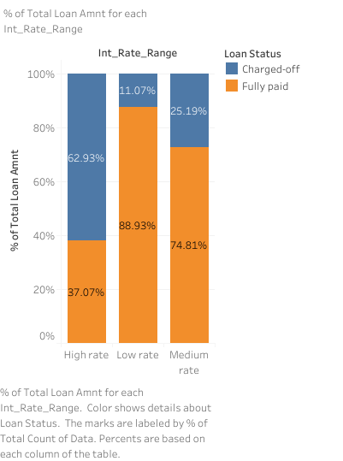
More than 62% of the have their credit charged off if the rate is of loan is higher. In our dataset, is higher every rate which is bigger than 16%. Do we have to say that the more the rate is higher, the more the risk of charged off is higher too. I will suggest them to reduce the amount of loan with a higher rate, by reducing the rate or reducing the amount of loans.

Slide 3
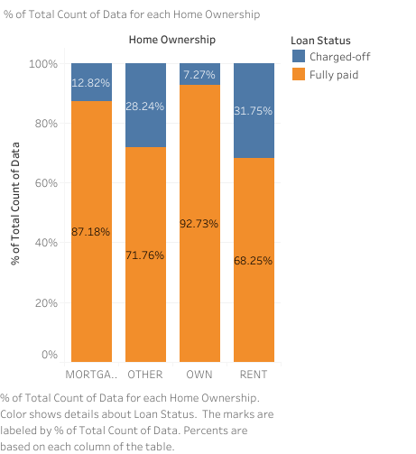
This graph shows a very interesting insight. Morre than 30% of people whose home ownership is a rent have their loan charger off. I will suggest them to be careful with this category of people.

Slide 4
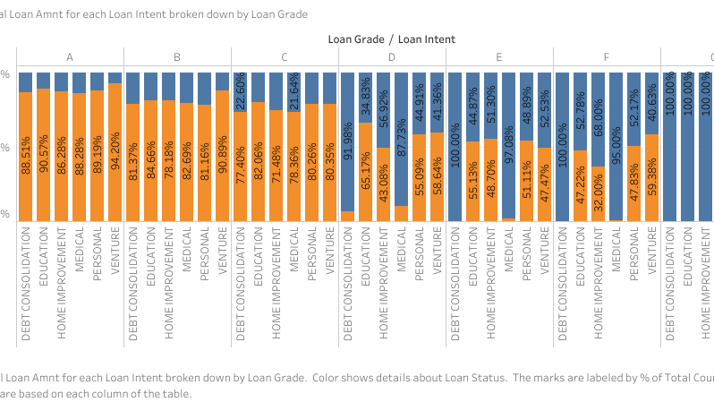

Slide 5
The precedent graph shows that for the 3 last grades or we can say the 3 risky grades are E, F, G. But there are 2 categories of people that we have to take away from loan, the ones who intend to take a loan for dept. consolidation and also the one who take a loan for medical. The worst category to give access to loan is people with grade G

Slide 6
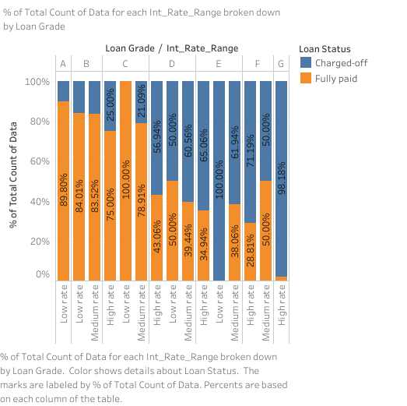
In this graph we can notice that they give a higher rate on loans of people in the last grade. Because of this more than 98% of the persons in this category have their loans charged off. They have to put another rate if they want them to pay their loans fully.

Slide 7
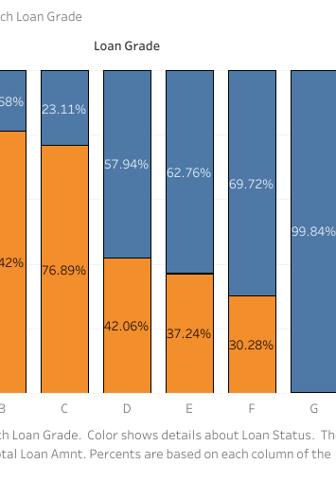
This graph shows 99.84% of people with loan grade G have their loan charged off. It’s the grade with the higher risk for loans to charged off.

Slide 8
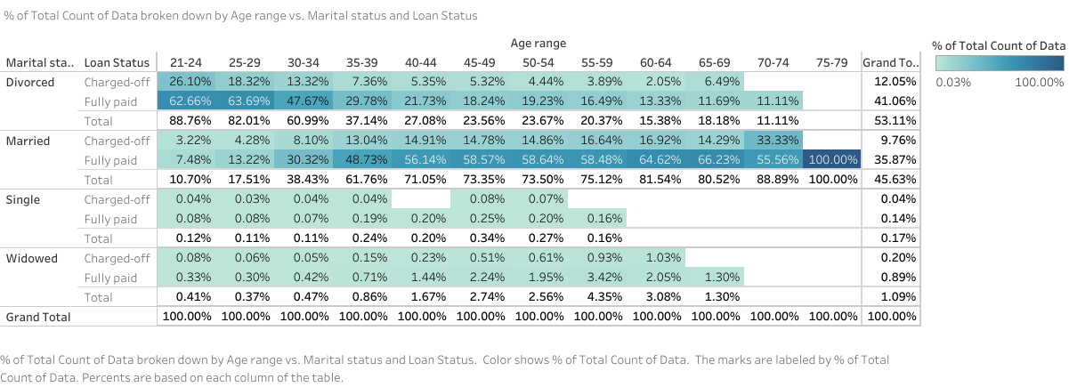
This table shows a summary of the data broken down by age range vs marital status and loan status.

Slide 9
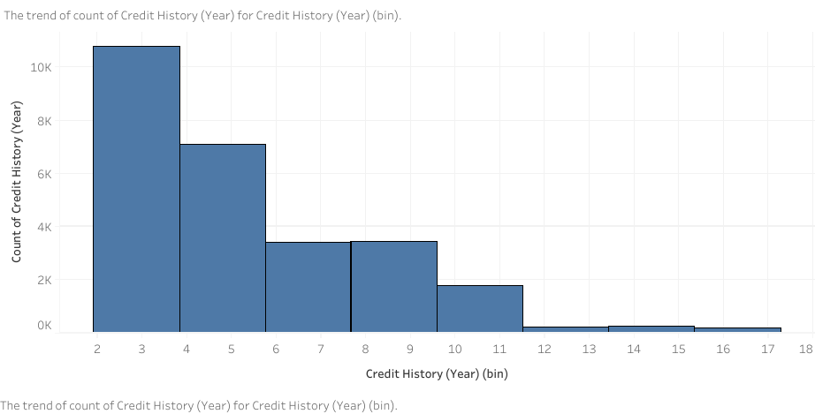
That’s the trend of count of credit history by year. It shows that by force that the number of years increases the number of persons to whom the credit is granted decreases.

Slide 10
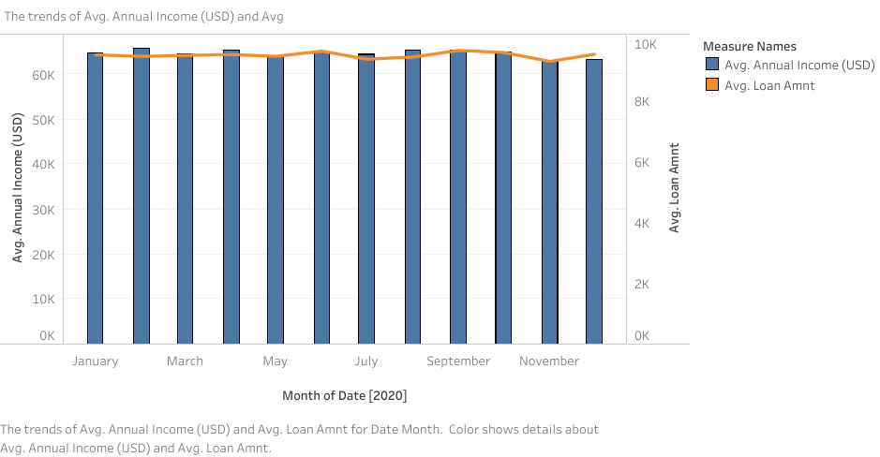
This is a graph which shows the trend of average annual income and average of loan amount. As we can notice, the average loan amount is higher than the average annual income on December. That means they give too much loans on December, because they don’t really focus on annual income.

